Slide 1

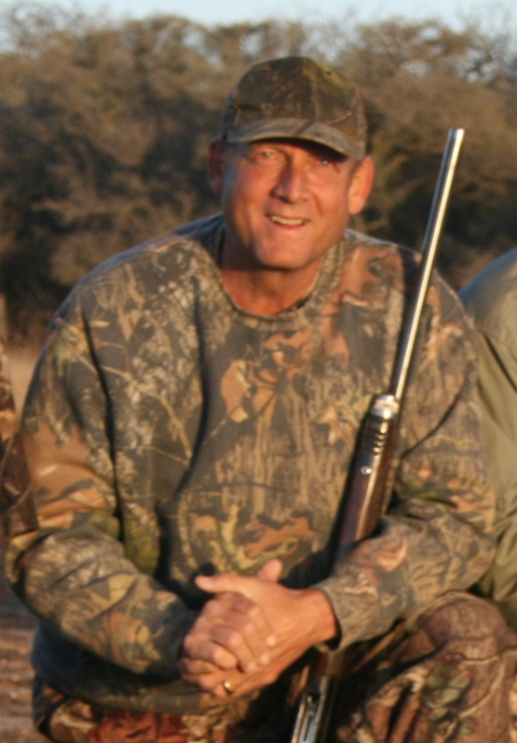
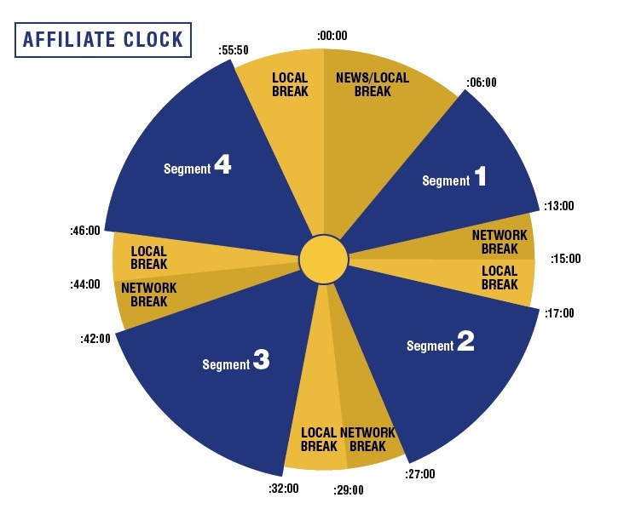
ON AIR
Saturday 6 a.m. to 8 a.m. ET
Kinder Outdoors
2 Hour Radio Show
FEED TIMES: AMC-8, SRN XDS , Sat. 6 a.m.-8 a.m. ET
Grab your cup of coffee and come on into the camp-house as All-American radio veteran Billy Kinder draws your audience into something enticing in outdoor radio…Outdoor Entertainment. Celebrity guests, pro staff and experts join Billy in fire side talk that will capture the ears and hearts of your listeners…they will tune in time and time again as they simply become a listening ear around the camp-fire…ALWAYS leaving with a smile and a tidbit or two of new knowledge.
“When we’re not in the
Great Outdoors,
we’re thinking about it.”
For Affiliate Sales, Contact:
(817) 360-8090

